Slide 1
Gallery Project

Slide 2
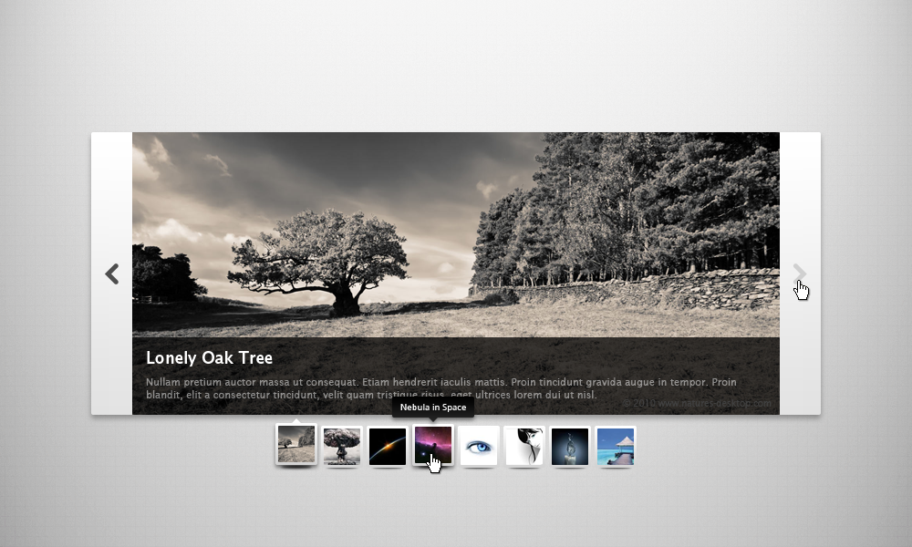

Slide 3
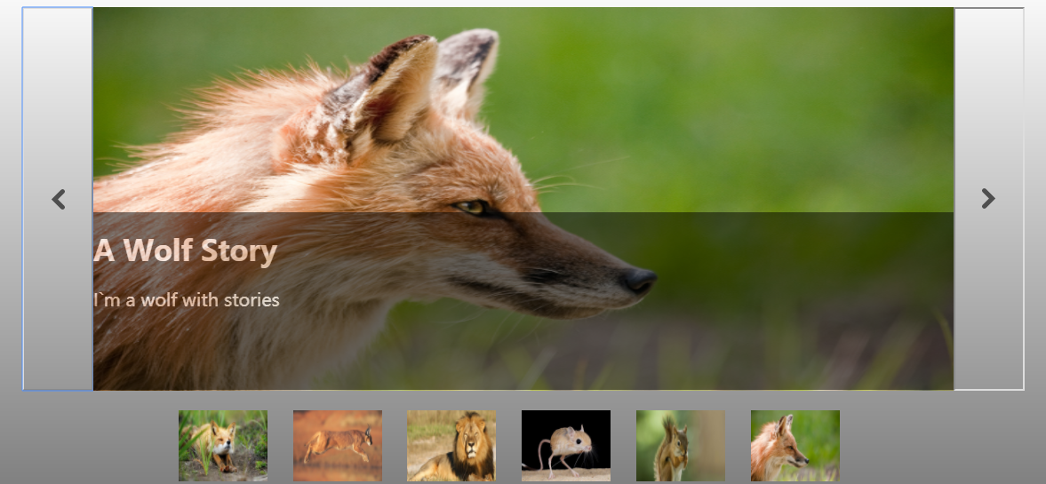

Slide 4
Most difficult part
CSS setting
JS Functions

Slide 5
What I have got?
Fundamental of Front-end Develop
HTML
CSS
JS

Slide 6


Slide 7

The end

